Slide 1
What is History?
Mr. Saindon
8th Grade Social Studies
Cal Poly

Slide 2
What is History?
What can be gained by the study of History?
What is the job of the Historian?

Slide 3
What is History?
Most people would say that history is the study of the important people, dates, and events of the past. This answer is true as far as it goes. But who decides what people, dates, and events are important? And why should we bother learning about them in the first place?

Slide 4
Famous People

Slide 5
Not So Famous People

Slide 6
More not so famous

Slide 7
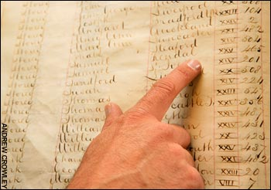
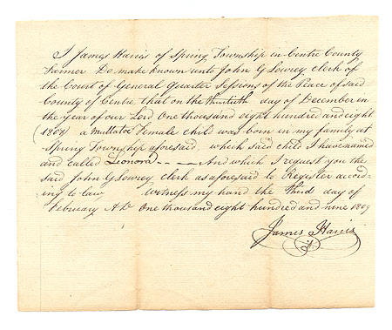
What is History?
1. History is the study of the past. Historians study records of past events and prepare new records. As new evidence is discovered, revisions and changes must be made.

Slide 8
2. We can learn a lot about today from studying the past.

Slide 9
History helps us understand the world around us!

Slide 10
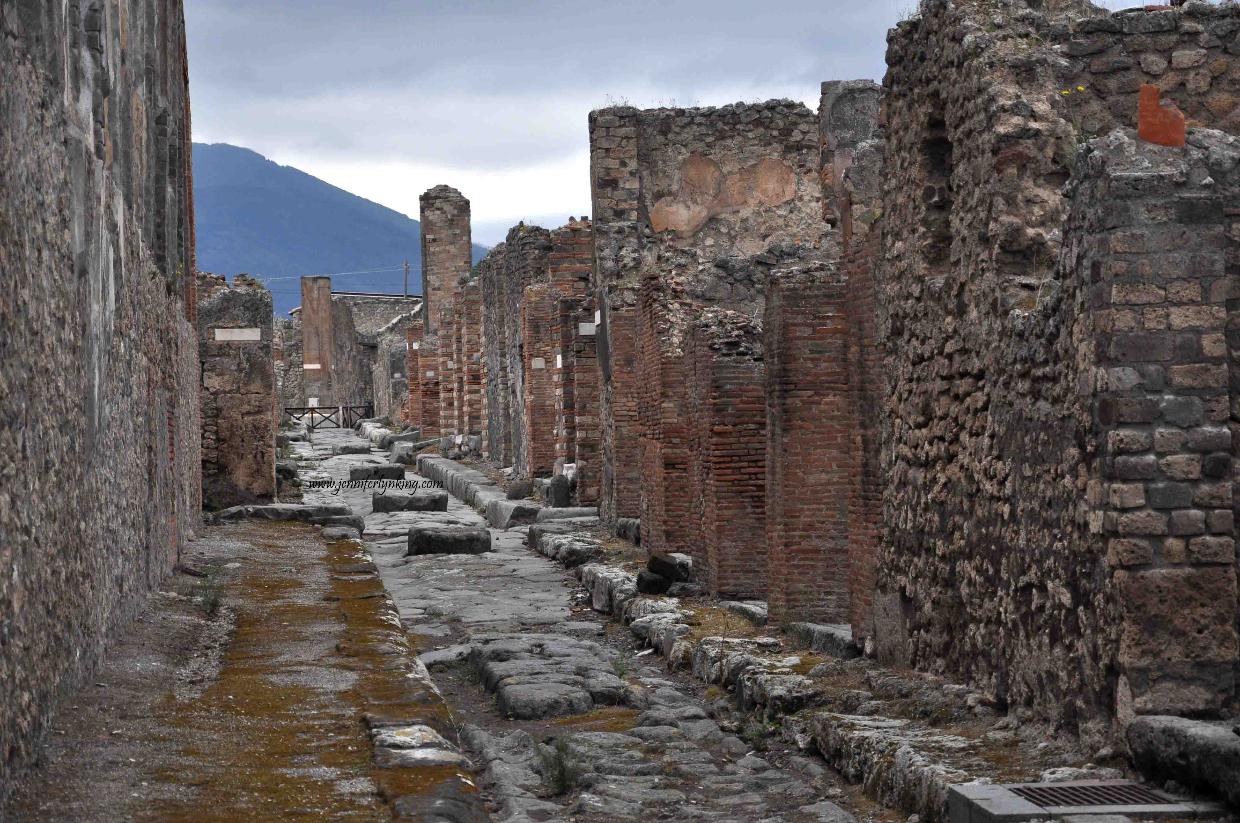
What is History?
3. What has been left behind that enables us to piece history together?

Slide 11
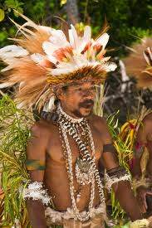
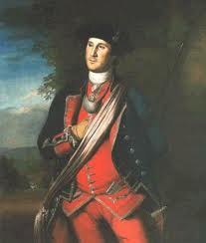
4. History helps us to better understand people and societies all over the world.

Slide 12
Cultural Universals

Slide 16
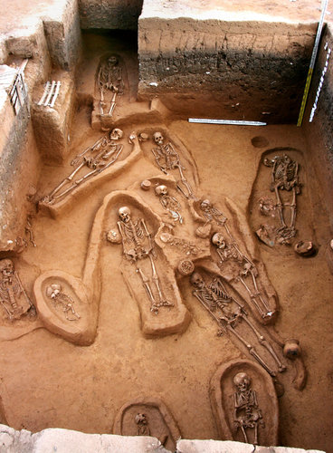
What can bones teach us?
 | December 18, 2012

Slide 17
5. Studying history helps to break down the walls of racism, fear, and ignorance.

Slide 22
#6. The study of history leads to the further understanding of others
Empathize
See things from another perspective
Put the pieces together and take an educated guess at what really happened
Take into account the human condition- people’s motives and desires
Take into account cultural universals
Look at the big picture

Slide 23
Everyone Has a Role In History
The study of History helps us understand who we are and where we came from.
History shows us that we ALL have a story to tell
We can see in history that people from all walks of life have contributed in some way (big or small) to making this country

Slide 24
The Ming Family

Slide 25
Our Spanish / Mexican Heritage

Slide 26
Spain and Mexico

Slide 27
Spain Colonizes California

