Slide 1
The Articles of Confederation
I. 1777 – Congress creates the Articles of Confederation – this document created a framework of laws for the first government of the United States. It lasted 10 years.
Major Sections of the Articles:
1. Each state had one vote in Congress
2. Congress could pass laws with the approval of 9 of the 13 states
3. Congress could declare war, appoint military officers and make money
4. Congress could not pass laws regarding taxes (to raise money, Congress had to ask the states)
5. Congress could not regulate trade or arguments between the states

Slide 2
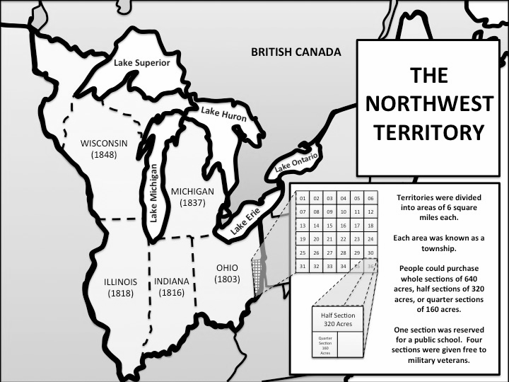
The Northwest Ordinance:
Under the Articles of Confederation, Congress created the Northwest Ordinance of 1787. Congress divided the territory into sections of 640 acres that were then given to citizens at a low cost. When the territory’s population reached 60,000, they could apply to become a state.

Slide 3
The Articles of Confederation set up a very loose organization of states, where that national government didn’t have much power. This led to many problems.
1. The U.S. owed millions of dollars, but had no way to pay it back
2. Many of the states were taxing goods that crossed into their borders and the states argued about the taxes often

Slide 4
3. Spain closed its port in New Orleans and the U.S. government had no way to stop them.
4. N.Y and N.H. both claimed Vermont (no way to settle the argument)

Slide 5
5. Britain refused to withdraw its troops from the Ohio River Valley.
6. Congress and the states each printed their own money, it was difficult to determine the money’s worth. Congress did not have enough gold or silver to make coins.

Slide 6
7. Shays’ Rebellion - Because of the money shortage, farmers in Massachusetts were ordered to sell their land to pay their debts. Daniel Shay led a rebellion by closing down courthouses to keep the judges from taking their farms, and to prevent them from jailing the debtors. He and his followers also seized an arsenal of weapons. Congress eventually sent in the militia to control the rebellion, but it showed Congress how little power they had. Shay’s Rebellion shocked Congress into changing the Articles of Confederation.

