Slide 1
The Judicial Branch

Slide 2
Last Time: the Executive Branch

Slide 3
Benchmark: SS.7.C.3.8 Analyze the structure, functions, and processes of the legislative, executive, and judicial branches.

Slide 4
Judicial Branch - is our nations court systems. These are where trials are held.

Slide 5
The courts and the judicial branch settles disputes.

Slide 6
The judge acts as a referee & the jury decides innocence or guilt called the verdict

Slide 7
A civil trial is a dispute between individuals or groups, to determine if “damages” have occurred

Slide 8
Another one of the main jobs of the courts is to interpret the laws. This means to explain the law using the constitution as a rule book

Slide 9
Courts were established in early Colonial America.

Slide 10
No Judicial Branch under the Articles of Confederation

Slide 11
Structure: Article III – “The judicial power of the United States, shall be vested in one Supreme Court”

Slide 12
Article III - “and in such inferior Courts as the Congress may from time to time ordain and establish.”

Slide 14
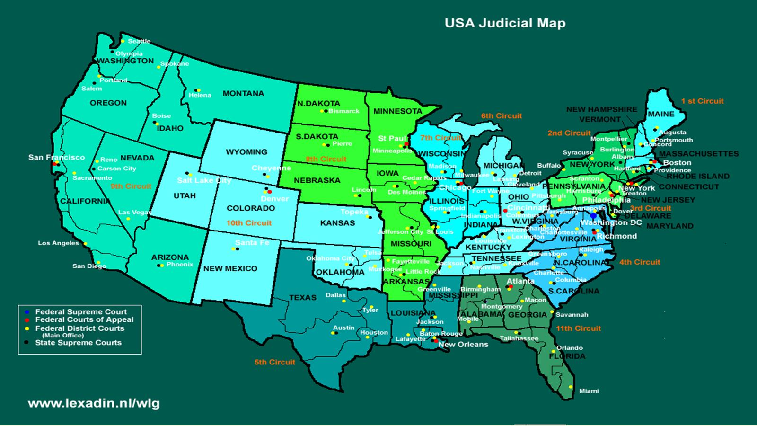
Vocabulary: Jurisdiction: the power to “hear” a court case Original Jurisdiction: the power to “hear” a case first

Slide 15
Dual Court System – there are 2 court systems in the United States

Slide 16
Vocabulary: Jurisdiction: the power to “hear” a court case Original Jurisdiction: the power to “hear” a case first

Slide 17
District Courts – where court cases start, “trial courts”

Slide 18
Vocabulary: Appeal / Appellate Court: to ask a higher court to reverse the decision of a trial court after final judgment or other legal ruling… Courts that hear appeals from trial courts

Slide 19
Court of Appeals – there is no jury or trial. 3 judge panel reviews the trial to make sure the law was applied correctly.

Slide 20
Supreme Court – highest court in the land. Hears cases from US Court of Appeals and state supreme courts.

Slide 21
Supreme Court –Made up of 9 justices appointed by the President who serve for “life”

Slide 22
What are the Powers of the Supreme Court? – the US Constitution is vague

Slide 23
Marbury v. Madison – 1803 – Chief Justice John Marshall claims the power to interpret the law

Slide 24
Marbury v. Madison – 1803

Slide 25
Example: Brown v. Board of Education 1954

Slide 26
Example: Brown v. Board of Education 1954

Slide 27
Judicial Review: the branches main check on the other two branches

Slide 28
Up Next: Landmark Supreme Court Cases

Slide 29
Review: Our nation’s court system is known as what branch?
The Judicial Branch

Slide 30
Review: What is the main job that the judicial branch has?
To interpret the law

Slide 31
Review: What was the name the judicial branch under the Articles of Confederation?
Nothing – there was no judicial branch

Slide 32
Review: What are the two types of trials?
Criminal & Civil

Slide 33
Review: What is the name of the group who decides the outcome of a trial?
Jury

Slide 34
Review: What was the only court created by the Constitution?
The Supreme Court

Slide 35
Review: America has a “dual court” system. What does that mean?
We have a federal (national) court system and state courts

Slide 36
Review: How many levels are there in the federal & state courts?
Three

Slide 37
Review: When someone loses @ trial and wants another chance they file an _______?
Appeal

Slide 38
Review: The power to hear a court case is known as?
Jurisdiction

Slide 39
Review: The power to declare laws “unconstitutional” is known as?
Judicial Review

Slide 40
Review: What Supreme Court case established judicial review?
Marbury v. Madison

Slide 41
Thanks for watching! Up next: Landmark Supreme Court Cases. Be sure to subscribe!

